Slide 1

Pick Your Place
Nia Maheshwari, Bella Matasic, Jahneulie Weste, Sanya Shrivastava, Trinity Bissahoyo
Notes:
Nia

Slide 2
Project Description
Drop-down menu of countries
Navigate to each countries page from the home page
A quick and easy way to create an informed travel itinerary!
Pick Your Place provides an all-in-one planner for popular cities in a country of your choice. You pick the cities you want to travel to and the top attractions, restaurants, and hotels that you want to visit in that location.
Notes:
Nia
Why did I come up with the idea? Talk about love for travel
Want to make these profitable

Slide 3


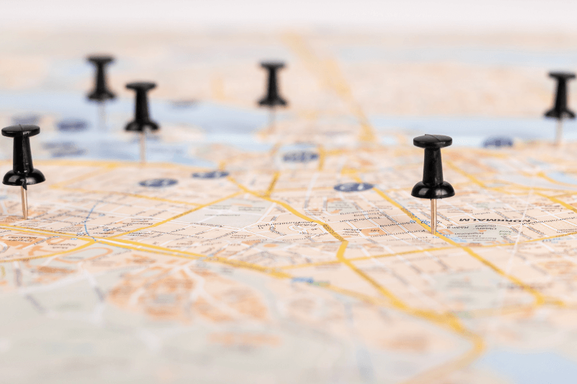
Brief Overview
LOCATIONS
ATTRACTIONS
CONSOLIDATION
Efficient Searching
Explore Cities of Interest
Top Spots
Places to Eat
Lodging
Create Bucket List
Emailed Bucket List to User
Notes:
Sanya (rule of 3 queen)
Brief Overview of the overall functionality of our website
Can all be summed up into 3 main things -> locations, attractions, and consolidation
Locations:
Users are able to search through cities or countries of interest efficiently
Brief description of each city all in one place
Attractions:
2 of each as of now
Top Spots
Places to Eat
Lodging
Consolidation:
Collective list of everything of interest to make a bucket list
Doesn’t only include cities/countries
Also have the option to include the attractions: top spots, places to eat, lodging
This list can be emailed to the user upon completion

Slide 4
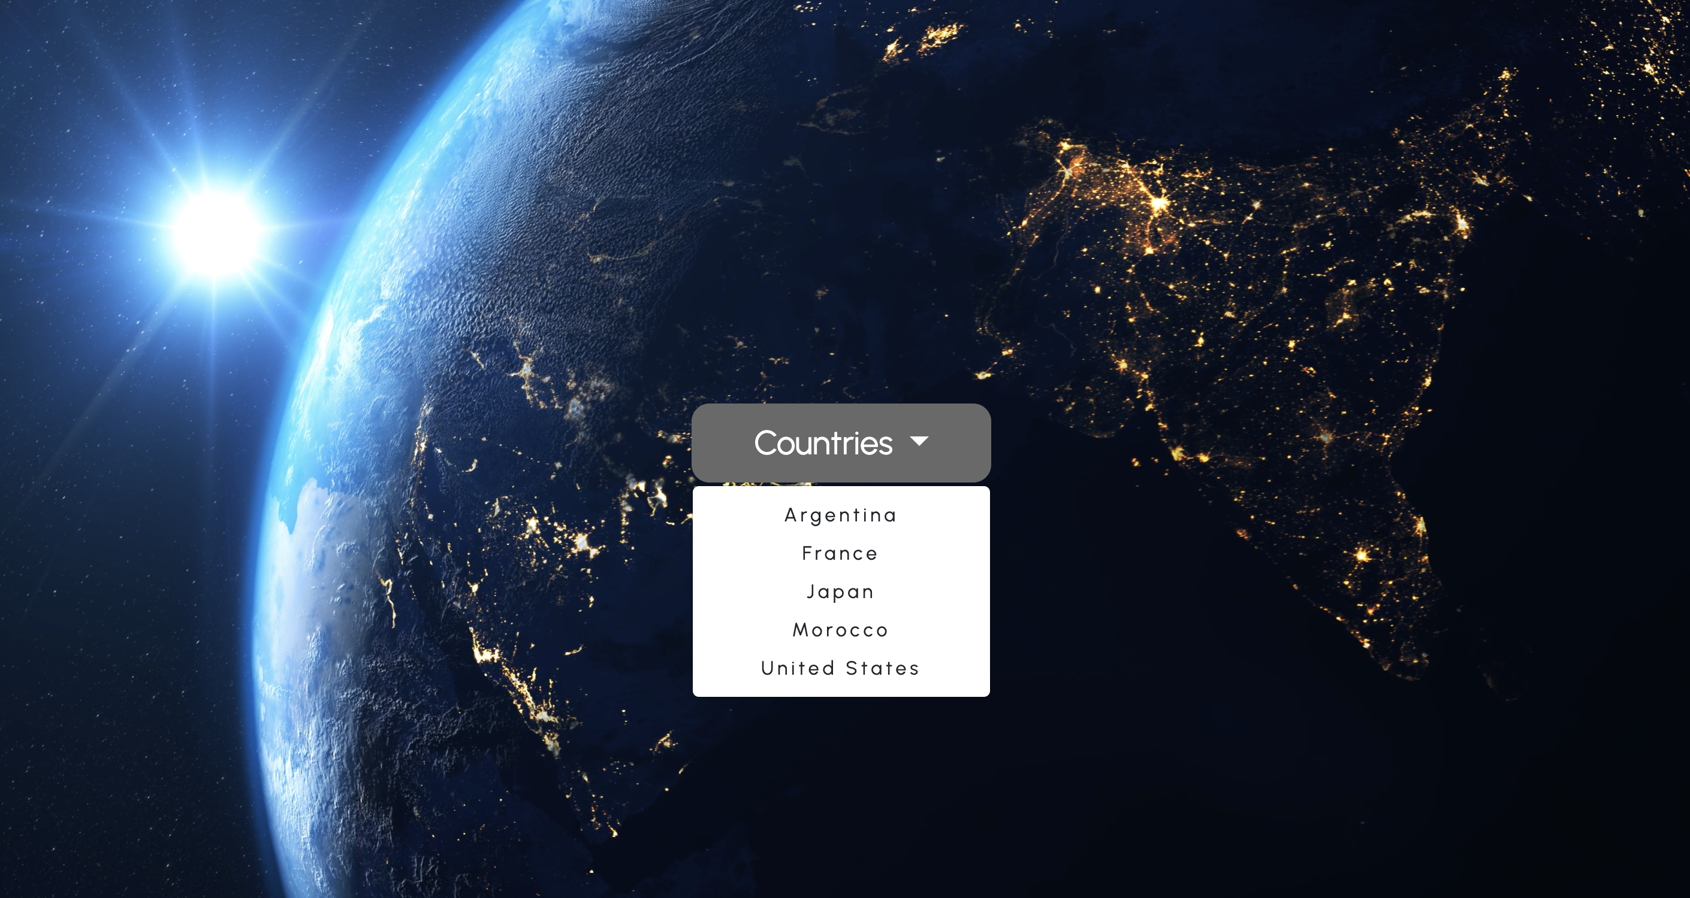
Locations
Drop-down menu of countries
Navigate to each countries page from the home page
Notes:
So this is the first page the user sees when opening the webpage
It is the home page and actually writes good morning or good afternoon to the user depending on the time of day it is
It shows all the countries available to look at and how you navigate to each countries page

Slide 5
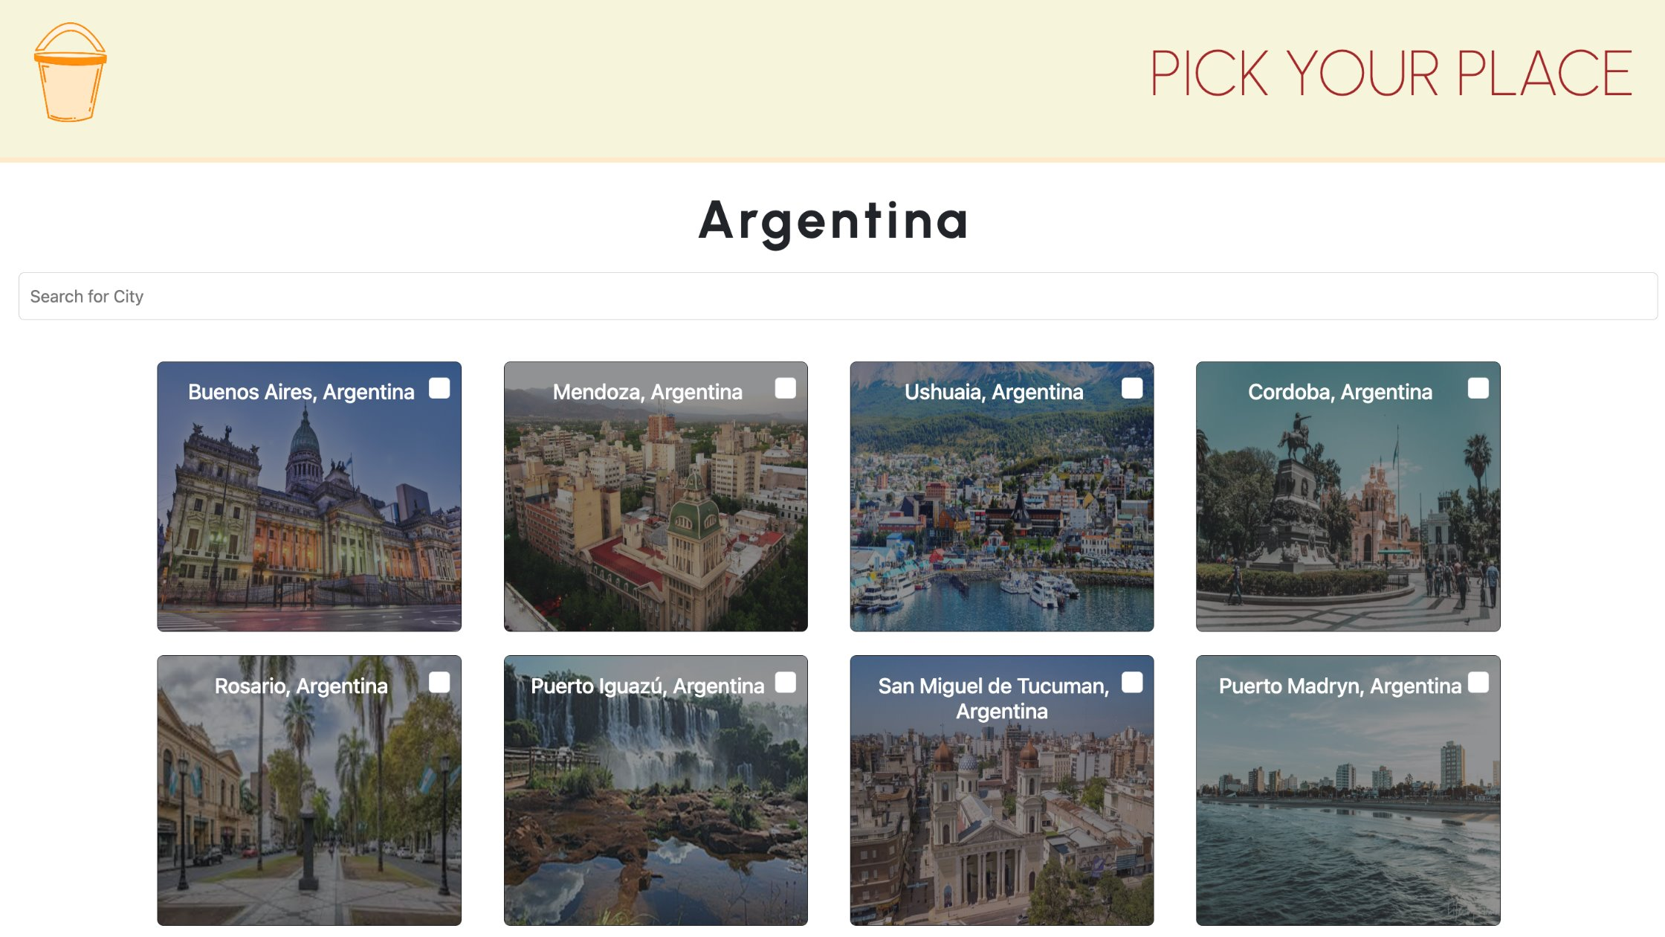
Locations
Collection of clickable city cards
Checkbox functionality to add + remove from bucket list
Detailed off-canvas menu triggered upon click
Search bar for quick look up!
Notes:
Here is an example of what a country page will look like
This is argentina, each country has city cards on them that include a checkbox to allow users to add/remove the city on their bucketlist
The user can click pick your place to go back to the home screen and go to another country
The bucketlist icon allows users to see what citys have been added
And lastly each page contains a search bar to allow you to look up a specific city your intersted in

Slide 6
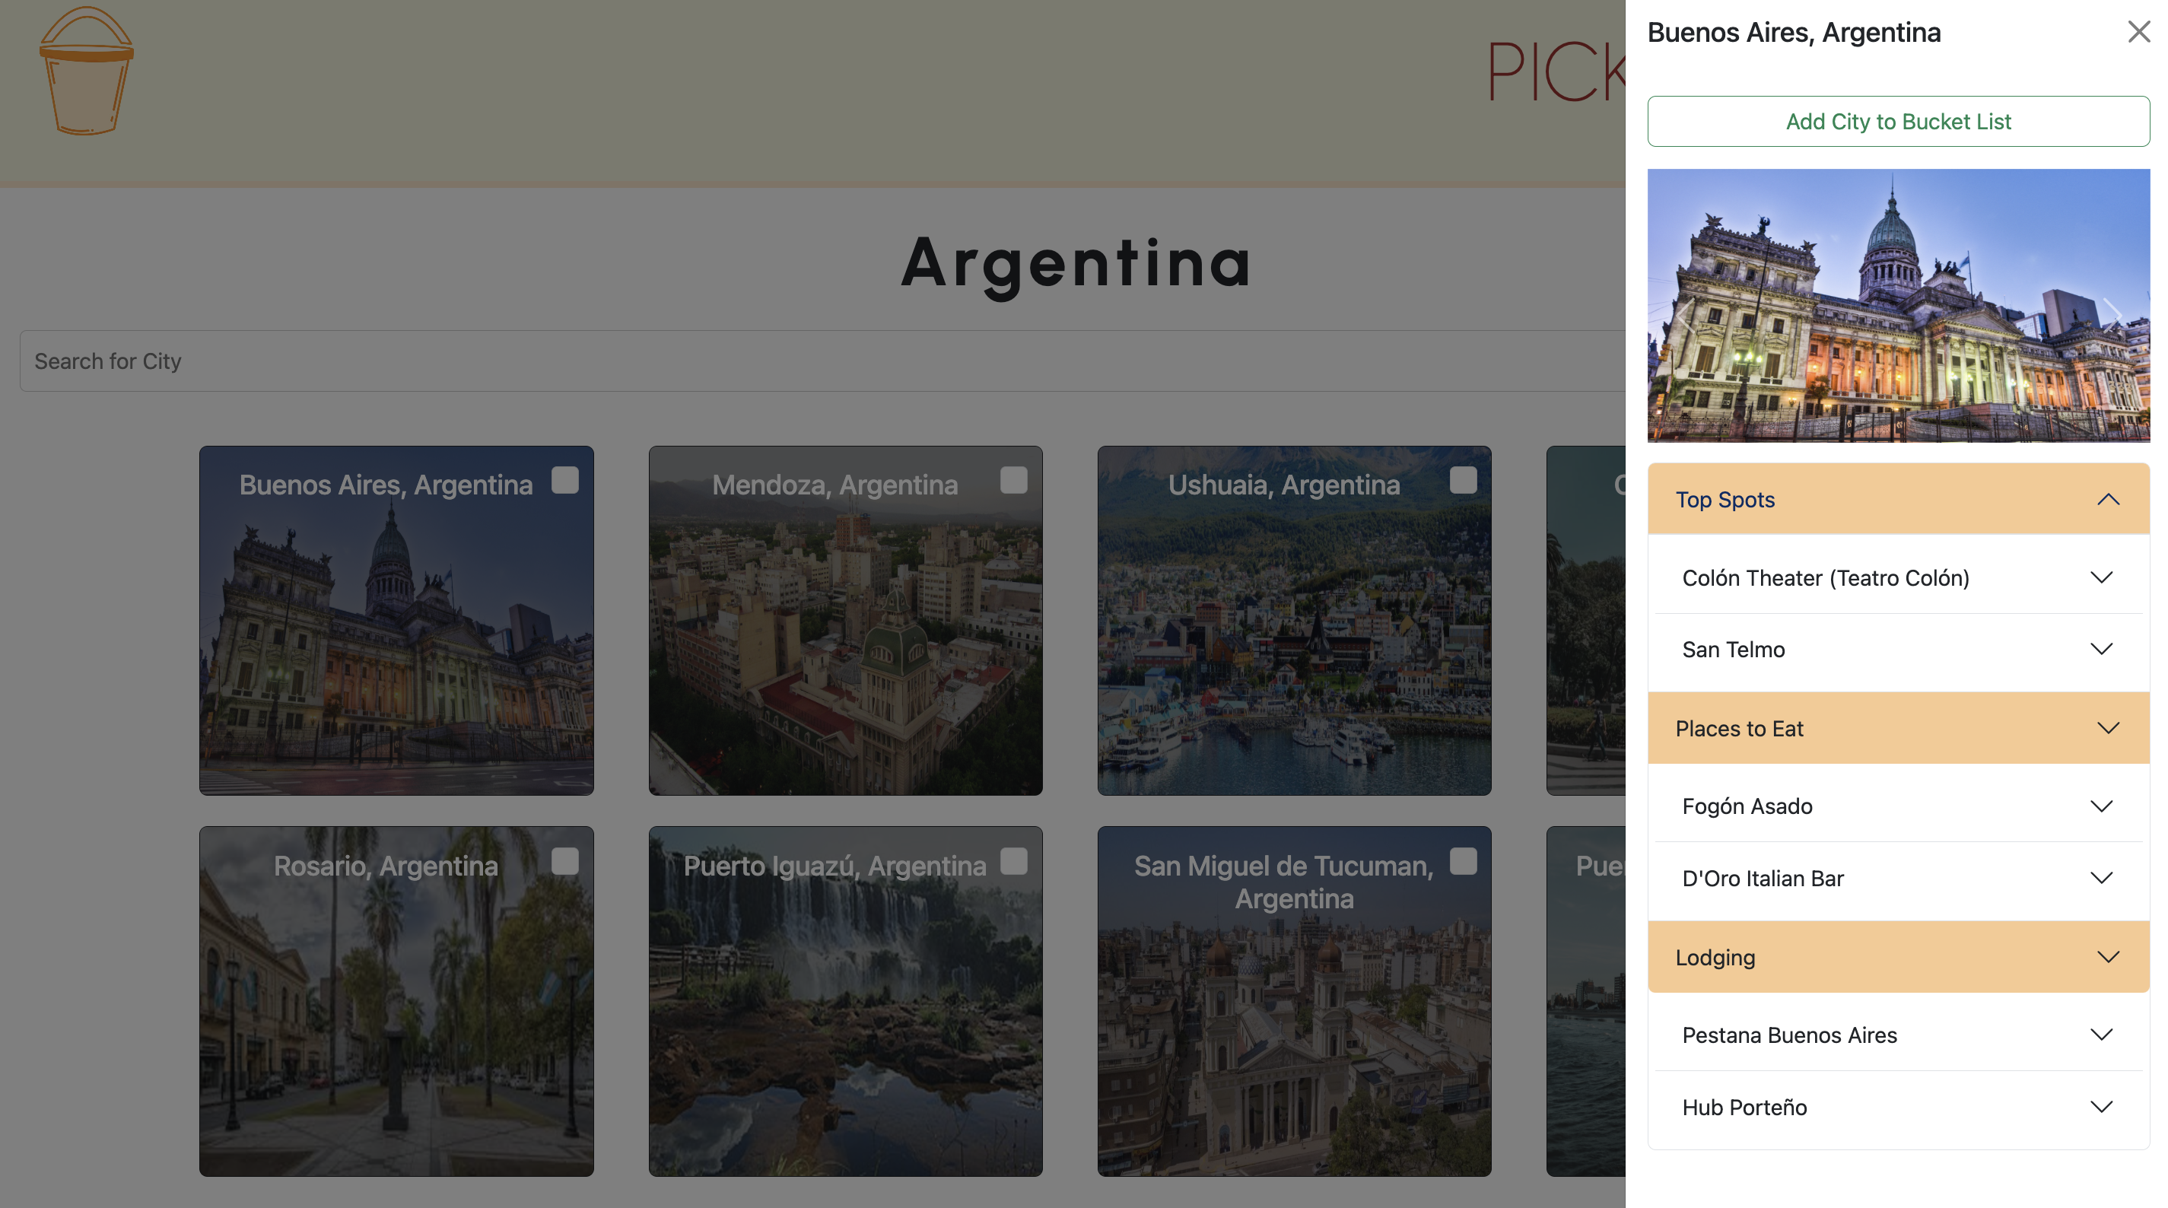
Attractions
Detailed off-canvas for each city
Accordion-style dropdown display
Provides summary of touristic attractions to make informed decisions
Notes:
Sanya
Each city -> its own detailed off canvas with a list of top spots, places to eat, lodging
Image carousel of each city
Accordion style dropdown display to show each attraction
All attractions are filled with a picture and a summary of tourist attractions

Slide 7
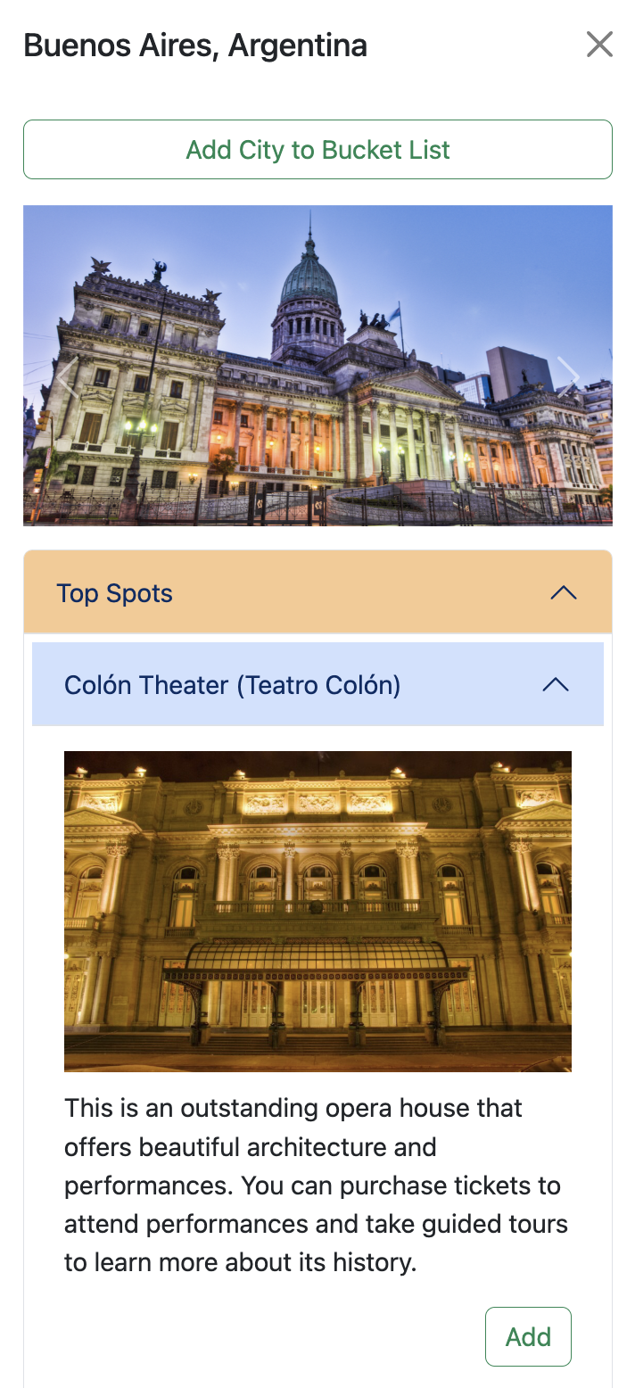
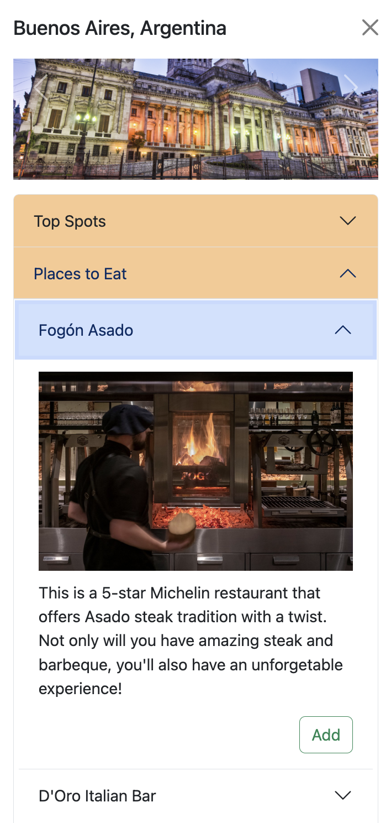
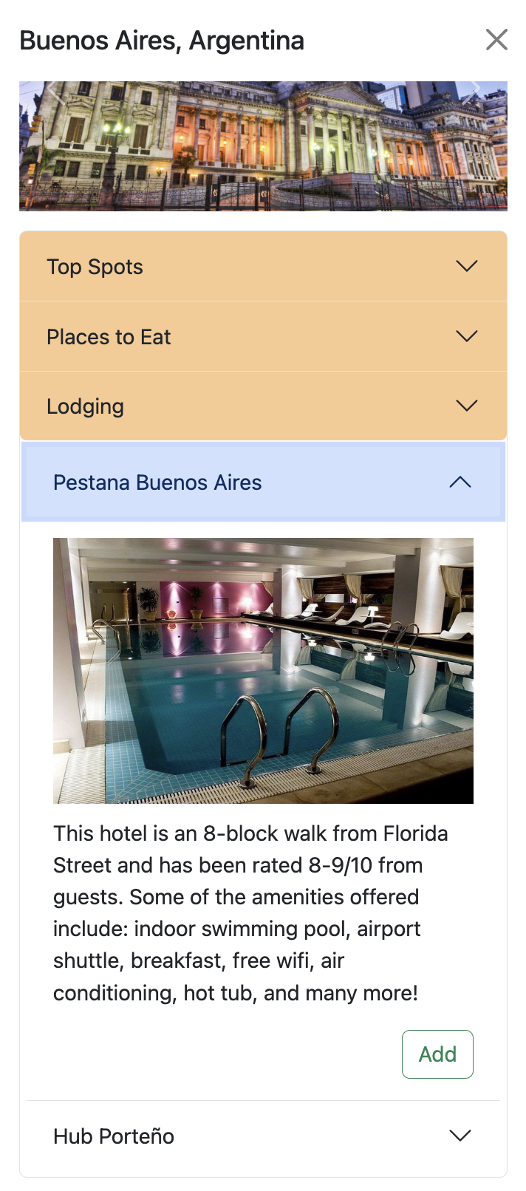
Attractions
Notes:
Sanya
All attractions are filled with a picture and a summary of tourist attractions
Each top spot, place to eat, or lodging can be added to the bucket list
Each attraction has its own add/remove button, which is directly connected to the bucket list
So when a user adds a city to their bucket list, it adds all their attractions along with it

Slide 8
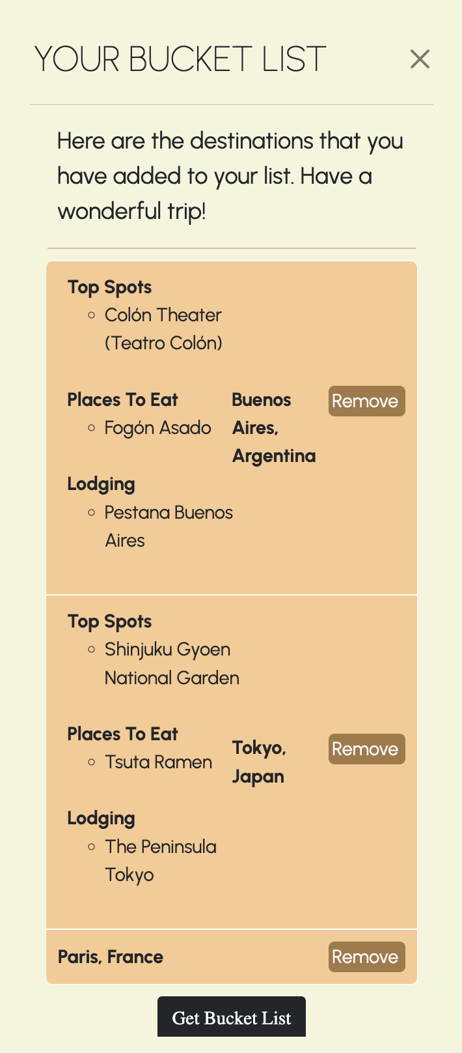
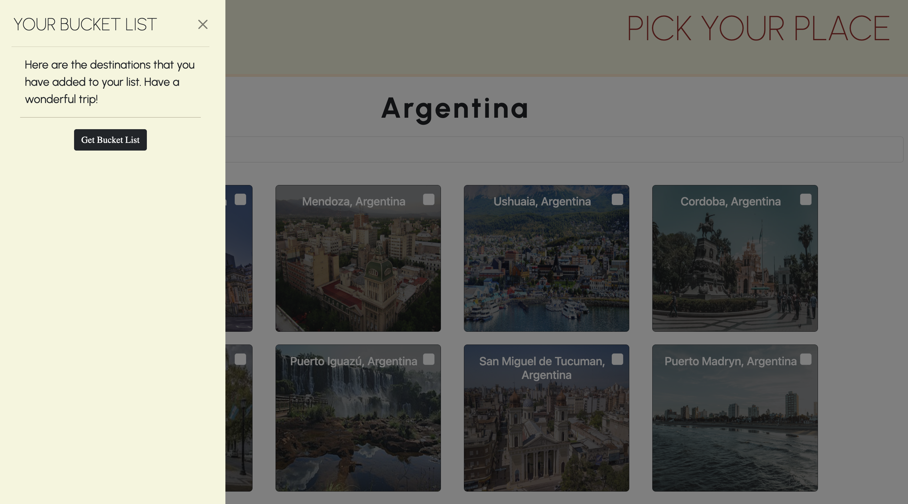
Consolidation
Notes:
Bella/Nia

Slide 9
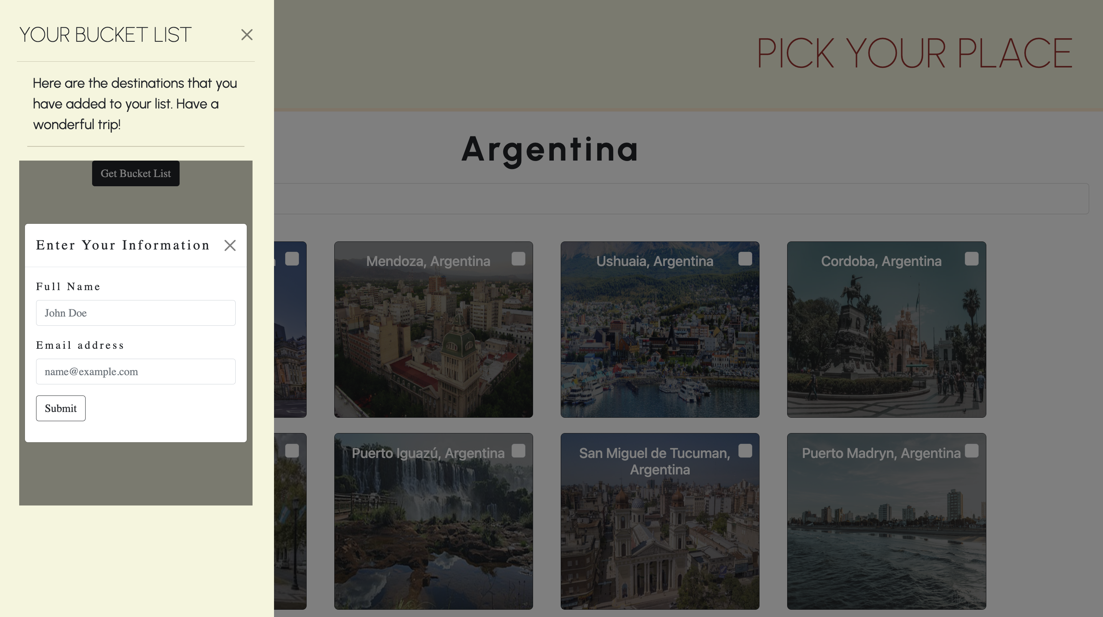
Consolidation
Notes:
Bella/Nia

Slide 10
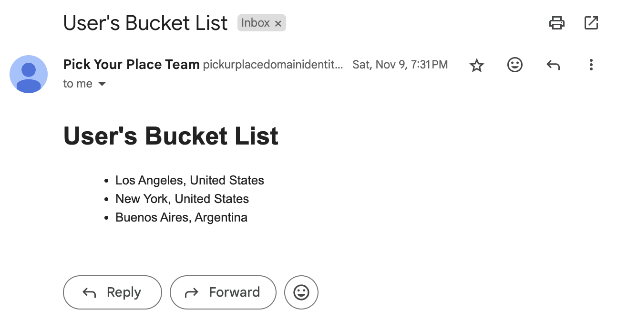
Emailed Bucket List
Notes:
Bella/Nia

Slide 11
Live Demo
Notes:
Jay

